Slide 1





Turbinando suas APIs: A Tríade Imbatível de Spring AI, OpenAI e AWS Bedrock para uma Eficiência Sem Precedentes
#pt-BR
#Uni2025-2

Slide 2
Artificial Intelligence Integration: Using Spring AI with OpenAI (ChatGPT) and AWS Bedrock to Deliver Efficient APIs
#en-US
#Uni2025-2

Slide 3





























About Me
Weder Mariano de Sousa
Specialist Senior Java - GFT
Technician System Development
Graduated Computer Science
Serverless
Post Graduate in Midias UFG
https://www.linkedin.com/in/wedermarianodesousa/
Post Graduate in Information Security
https://github.com/weder96
https://twitter.com/weder96
https://dev.to/weder96
GOJava
AWS User
Group Goiânia
AWS User
Group Anápolis

Slide 4


Agenda
Introduction
Topic 1: Generative AI – Concepts and Advantages
Topic 2: Getting to Know OpenAI and AWS Bedrock
Topic 3: Integration: Spring AI with OpenAI (ChatGPT)
Topic 4: Integration: Spring AI with AWS (Bedrock)
Topic 5: Presentation of the integration architecture AWS Bedrock
Conclusion
Level: 100-200
(*The level can be adjusted by the presenter to meet the needs of the audience.)

Slide 5
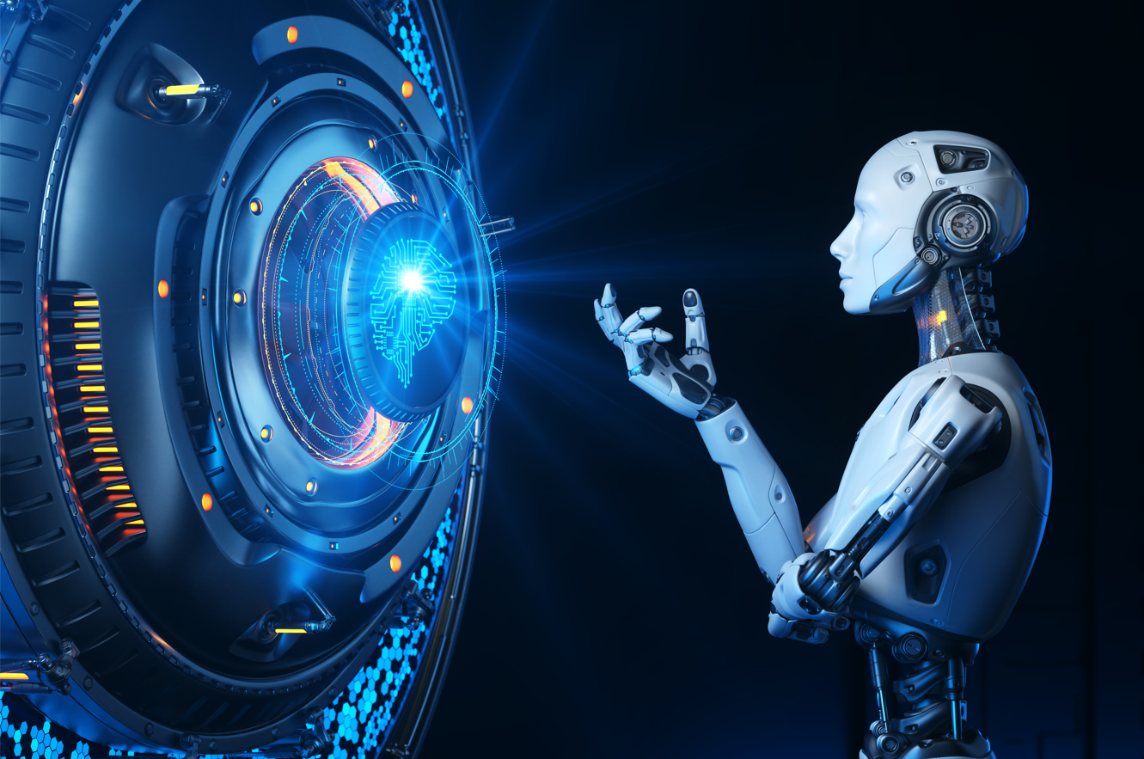
Generative AI
Topic 1: Generative AI – Concepts and Advantages

Slide 6


Generative AI

Slide 7

What is Generative AI
Image
Text/Chat
> Question: What is generative AI?
Generative AI refers to a type of
artificial intelligence that is capable
of creating new and original content.
It uses algorithms and machine learning
to generate text, images, music, and
other forms of media based on patterns
and rules learned from existing data.
Generated with OpenAI Image Generator G1
Generated with OpenAI Image Generator G1
Create an image of a puppy eating a popsicle

Slide 8
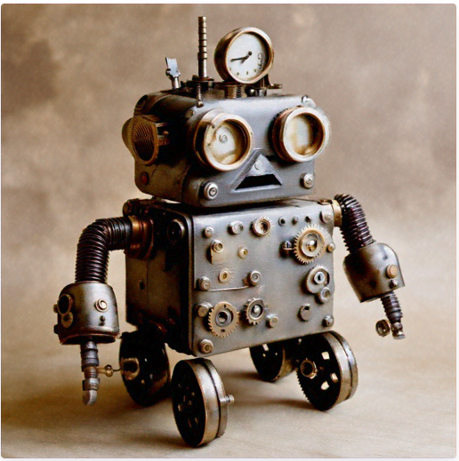
What is Generative AI
Image
Text/Chat
> Question: What is generative AI?
Generative AI refers to a type of
artificial intelligence that is capable
of creating new and original content.
It uses algorithms and machine learning
to generate text, images, music, and
other forms of media based on patterns
and rules learned from existing data.
Generated with Amazon Titan Text G1 - Express
Generated with Amazon Titan Image Generator G1
A stylized picture of a cute old steampunk robot

Slide 9



What is Generative AI
Artificial Intelligence
Machine Learning
Deeping Learning
Supervised
LLMS
Generative AI

Slide 10

Machine Learning

Slide 11
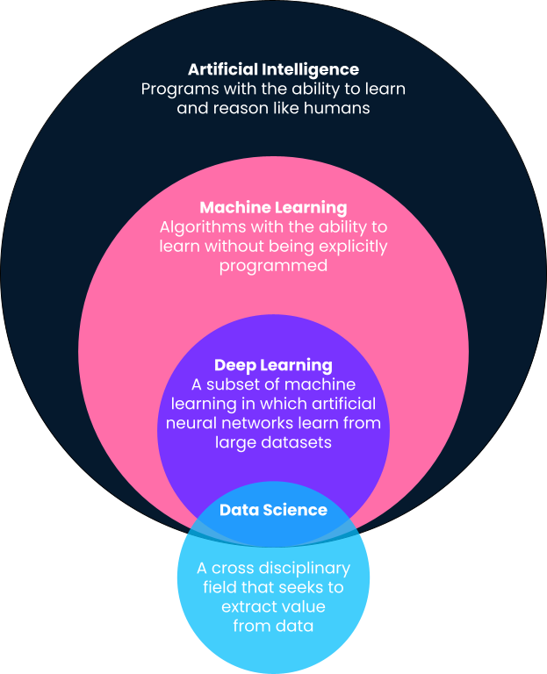
What is machine Learning?
Training Data
Model
Predictions
Notes:
What is Machine Learning?
Machine Learning, often abbreviated as ML, is a subset of artificial intelligence (AI) that focuses on the development of computer algorithms that improve automatically through experience and by the use of data. In simpler terms, machine learning enables computers to learn from data and make decisions or predictions without being explicitly programmed to do so.
At its core, machine learning is all about creating and implementing algorithms that facilitate these decisions and predictions. These algorithms are designed to improve their performance over time, becoming more accurate and effective as they process more data.
In traditional programming, a computer follows a set of predefined instructions to perform a task. However, in machine learning, the computer is given a set of examples (data) and a task to perform, but it's up to the computer to figure out how to accomplish the task based on the examples it's given.
For instance, if we want a computer to recognize images of cats, we don't provide it with specific instructions on what a cat looks like. Instead, we give it thousands of images of cats and let the machine learning algorithm figure out the common patterns and features that define a cat. Over time, as the algorithm processes more images, it gets better at recognizing cats, even when presented with images it has never seen before.
This ability to learn from data and improve over time makes machine learning incredibly powerful and versatile. It's the driving force behind many of the technological advancements we see today, from voice assistants and recommendation systems to self-driving cars and predictive analytics.

Slide 12

Machine Learning
Use Cases
Facial Recognition
Recognize Tumors on x-ray scans
Abnormality on ultrasounds
Self-driving mode (recognize stop sign / pedestrian / etc)
Fraud detection
Product Recommendations (YouTube)
Spam Filtering

Slide 13
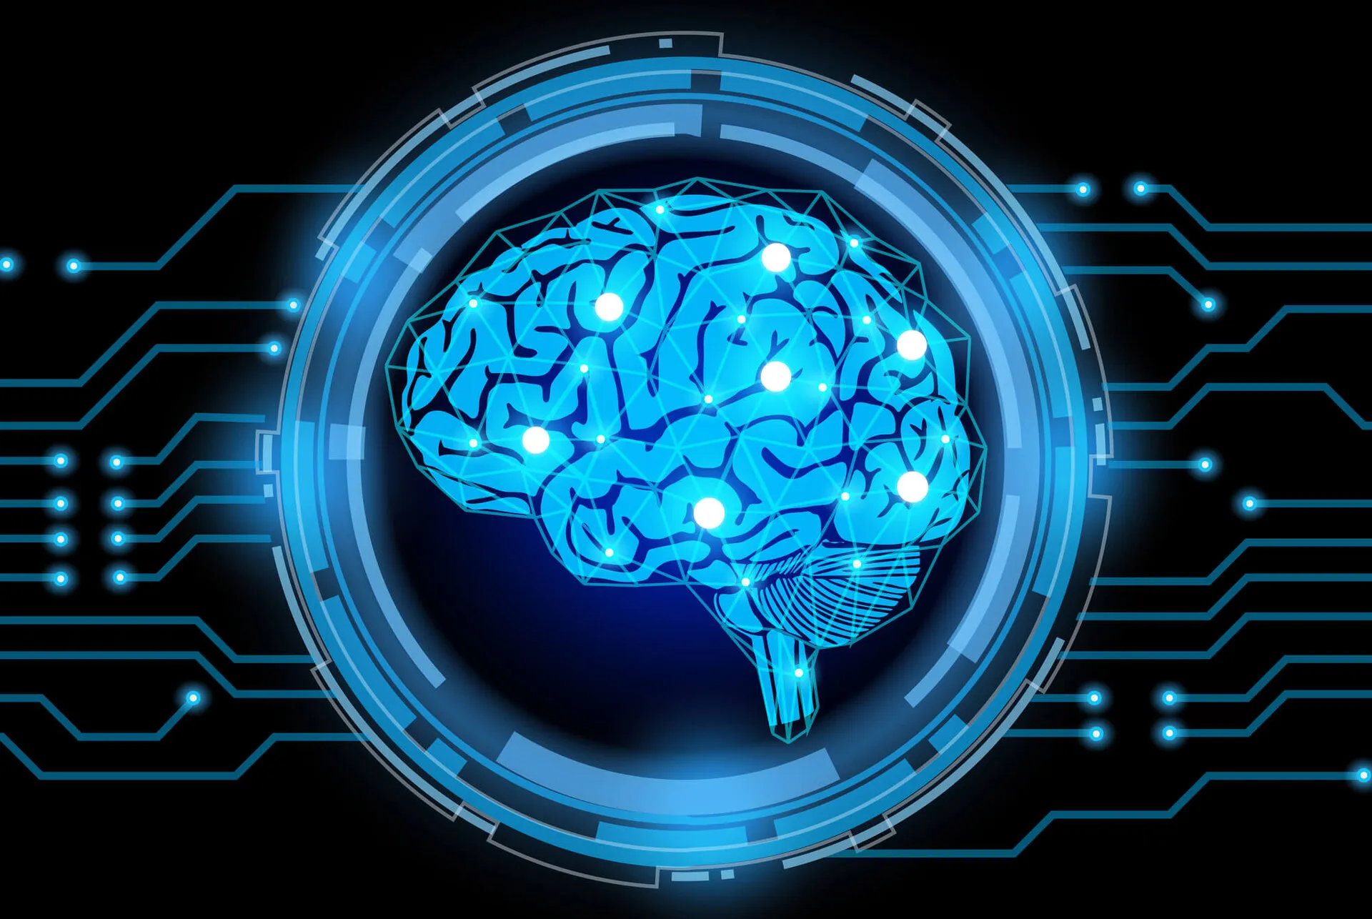
Deep Learning

Slide 14
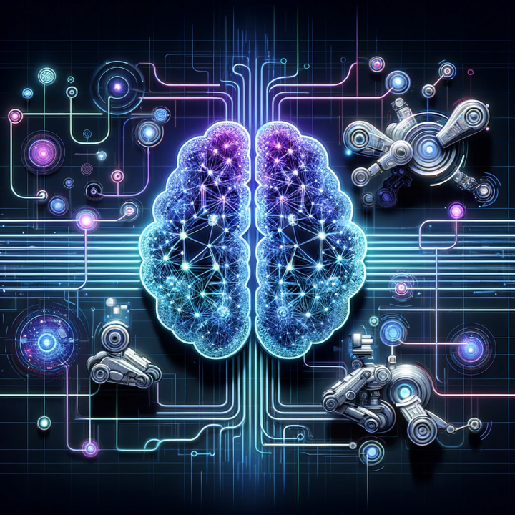
Artificial Neural Network
Scientific Advances - Deep Learning
Availability of Big Data
(You need data to configure these neural networks)
Lots of Compute Power

Slide 15
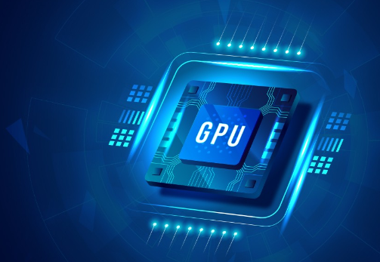
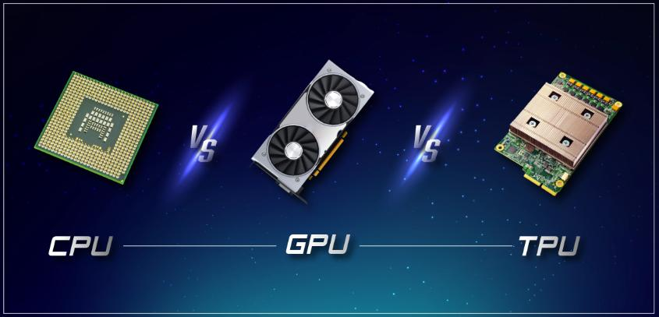

Slide 16

Large Language Models (LLM)

Slide 17

Large Language Models So what are LLMs
LLMs are a type of artificial intelligence that can generate text, understand language, answer questions and more.
They are large because they have a vast number of parameters, which are the parts of the model that are learned from data during training.
ChatGPT
175 Billion Parameters
Training Data - Hundreds of Billions of words

Slide 18
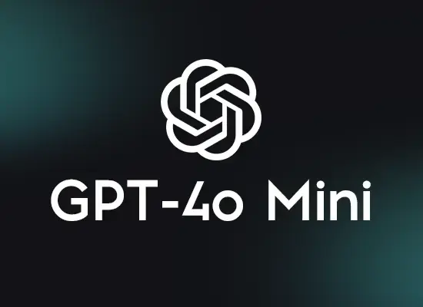
Describe your qualities to me explaining to a developer ?
Sure! Here are some key qualities I can describe, specifically in the context of a developer:
Access to Information: I have access to a wide range of information and knowledge...
Troubleshooting: I am able to help identify and resolve software issues by providing diagnostics...
Multi-Language Support: I can provide support for a variety of programming languages...
Documentation and Reference: I have the ability to generate and explain documentation for APIs...
Continuous Learning: I am always up to date with my latest knowledge...
Project Management Assistance: In addition to helping with the actual coding...
Personalization of Answers: I can tailor my answers to the developer’s level of knowledge...
Tool and Libraries Suggestions: I can recommend tools, libraries...
These qualities make me a valuable resource for developers looking for quick information, support, and solutions to their coding challenges.

Slide 19
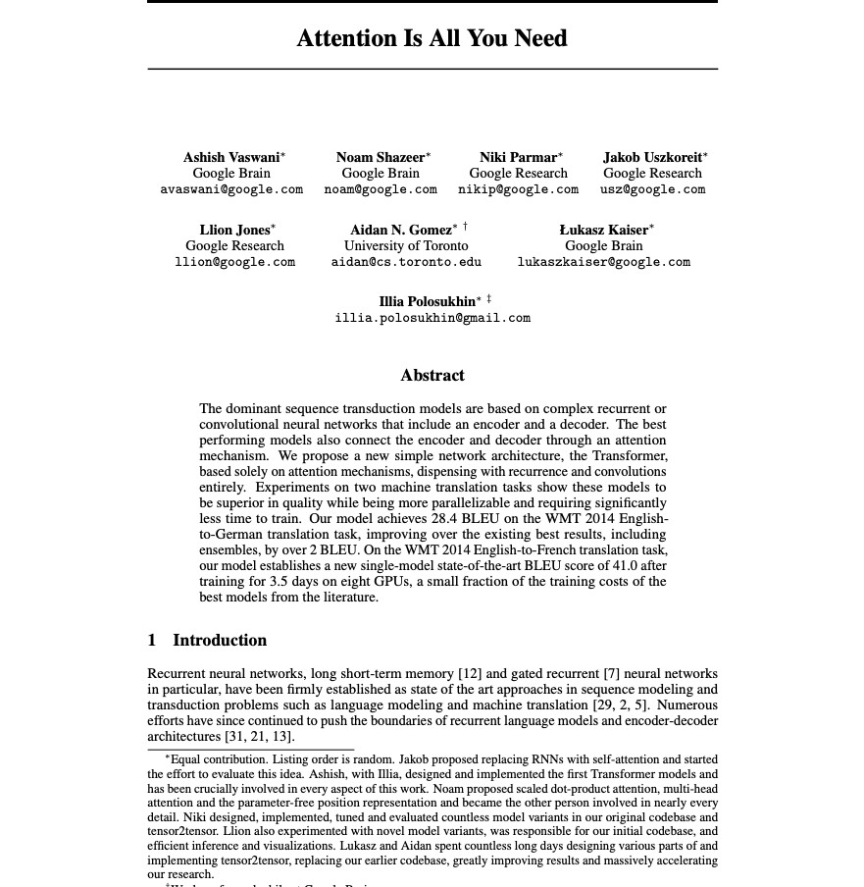

Attention is all you need
"More good data leads to better AI."
Very Large Neural Networks
Vast Amounts of Training Data
Huge Compute Power to Train Data
General Purpose AI
https://proceedings.neurips.cc/paper_files/paper/2017/file/3f5ee243547dee91fbd053c1c4a845aa-Paper.pdf

Slide 20
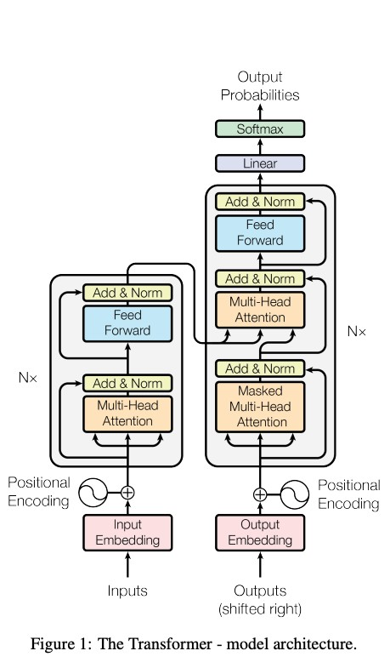
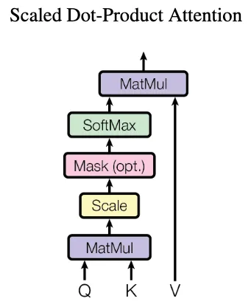
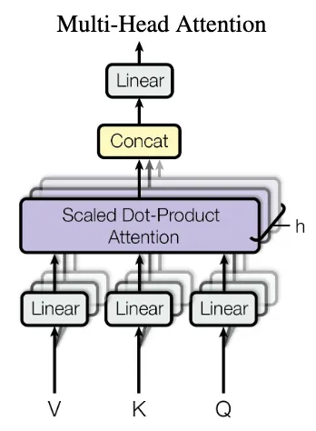
Attention is all you need
Transformer Architecture
Specialized architecture for token prediction
Key Innovation
Attention mechanisms
Not Just a big neural network
https://blog.roboflow.com/what-is-a-transformer/

Slide 21
WHAT ARE AI MODELS?
AI
AI
AI
AI
AI

Slide 22


As Artificial Intelligence (AI) models become more important and widespread in almost every sector, it is increasingly important for businesses to understand how these artificial intelligence models work and the potential implications of using them.
Artificial Intelligence (AI)
Models
AI models and their various applications.
We will explore popular use cases of AI models and discuss how they can be used effectively in business and other settings.
https://viso.ai/deep-learning/ml-ai-models/

Slide 23
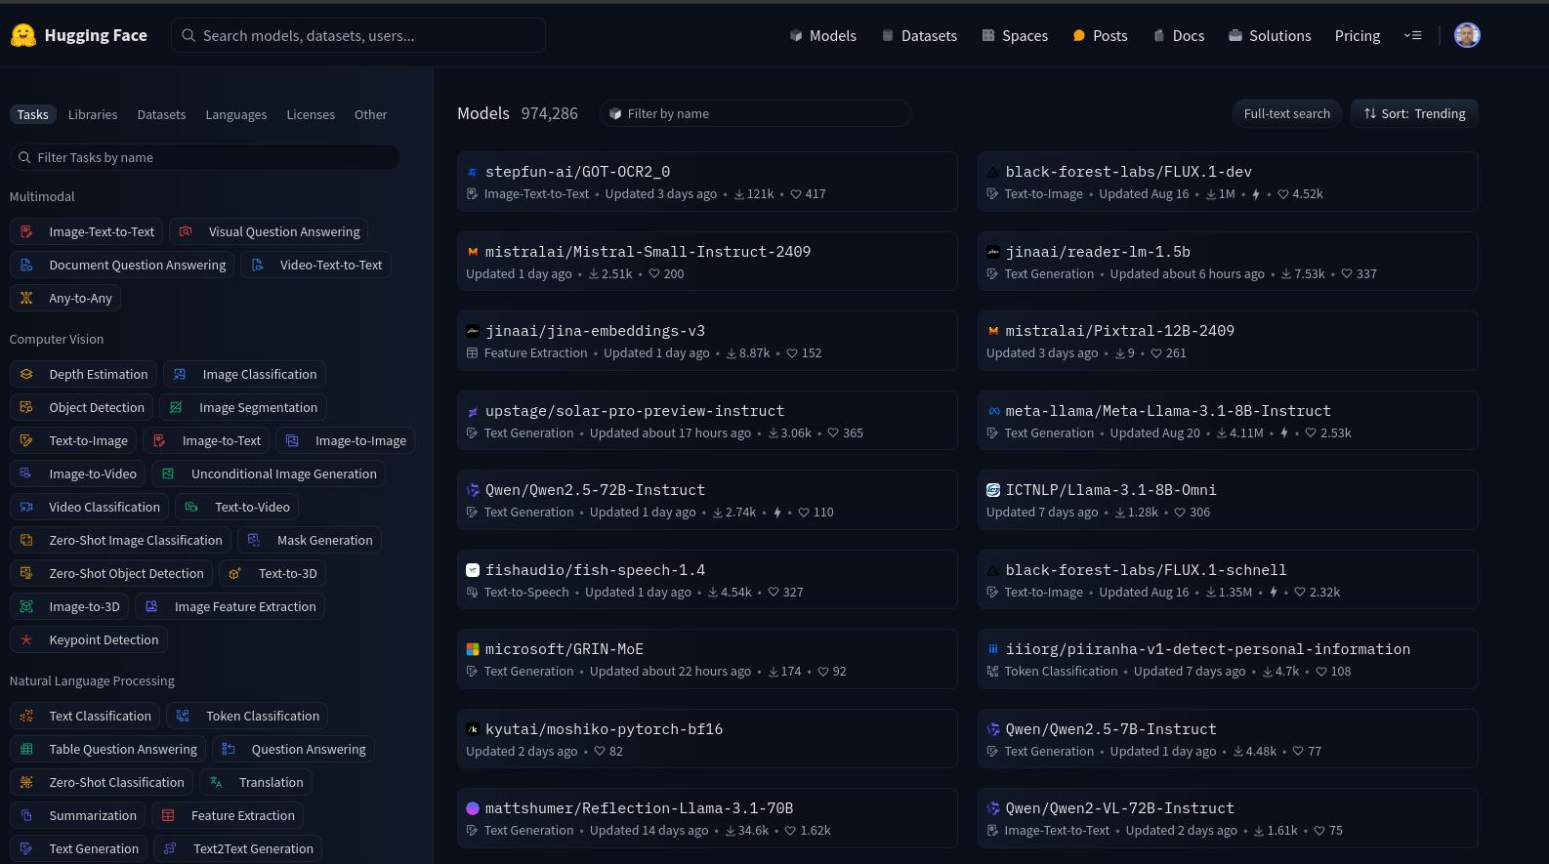

https://huggingface.co/models

Slide 24

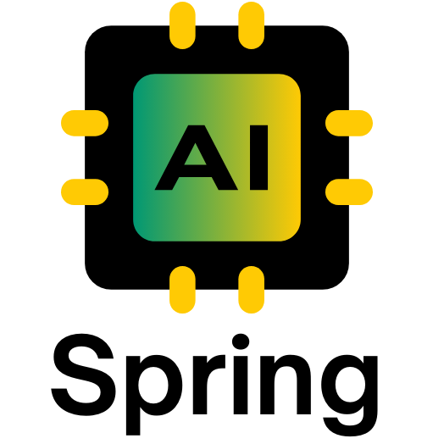

Slide 25


WHAT IS SPRING AI

Slide 26
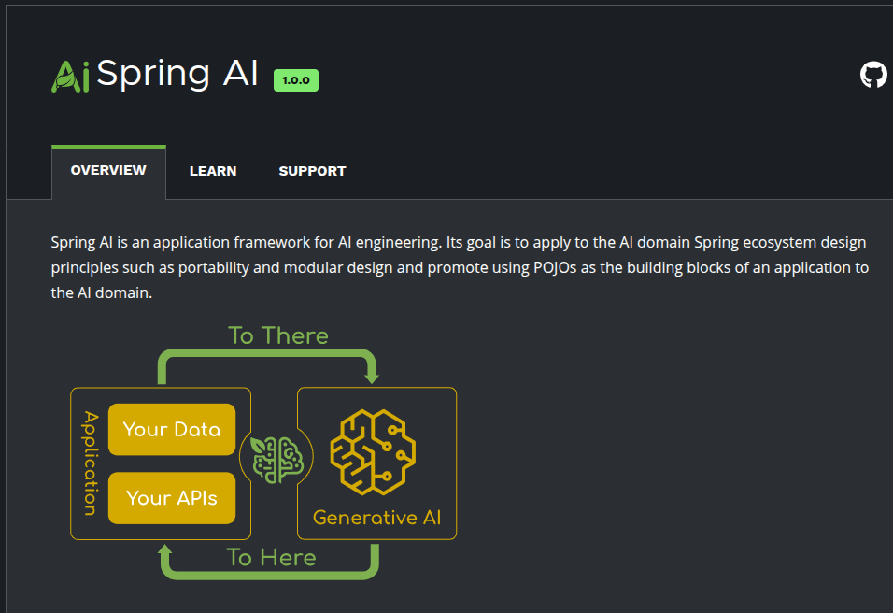

Spring AI
AI for Spring Developers
A new Spring Project
Mark Pollack
Current Version 1.0.0 https://spring.io/projects/spring-ai
Inspired by Python projects
LangChain
LllamaIndex
https://docs.spring.io/spring-ai/reference/index.html

Slide 27
Spring AI
AI for Spring Developers
Aligns with Spring project design values
Component Abstractions & Default
Implementations
Portable Chat Completion and
EmbeddingClient
Multimodality Support
Portable Vector Store API & Query
Language
Function Calling
Key Components
https://docs.spring.io/spring-ai/reference/index.html

Slide 28
Spring AI API
The Spring AI API covers a wide range of functionalities
Chat Model
Text to Image
Transcription
Give it some text,
get some text back
Give it some text,
get an image back
Give it some audio,
get some text back
Embedding
Functions
AI model invoke your POJO
java.util.Function. Object
Portable API across
Vector Store Providers

Slide 29

Chat Model
Give it some text, get some text back
Open AI
Azure Open AI
Amazon Bedrock
Google Vertex AI Palm
Google Gemeni
HuggingFace - Access to thousands of models, including those from Meta such as Llama 2
Ollama - Run AI Models on your local machine
MistralAI

Slide 30

Text-to-Image Models
Give it some text, get an image back
OpenAI with DALL-E
StabilityAI

Slide 31

Transcription
Give it some audio, get some text back
Open AI

Slide 32

Embedding Models
Portable API across Vector Store providers
Open AI
Azure Open AI
Ollama
ONNX
PostgresML
Bedrock Cohere
Bedrock Titan
Google VertexAI
MistalAI

Slide 33

WHAT ARE AI PROMPTS?

Slide 34
Prompts serve as the foundation for the language-based inputs that guide an AI model to produce specific outputs. For those familiar with ChatGPT, a prompt might seem like merely the text entered into a dialog box that is sent to the API. However, it encompasses much more than that. In many AI Models, the text for the prompt is not just a simple string.

Slide 35
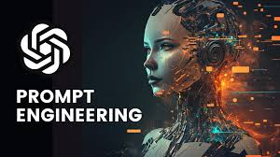
Prompt Engineering
Effective Communication
Input directing an AI model to produce specific outputs
Model outputs are greatly inference by prompt style and wording
Prompt Engineering
Prompt techniques and effective prompts are share in the community
OpenAI Guidelines
Mini Course: ChatGPT Prompt Engineering for developers
Prompts and Spring
Prompt management relies on Text Template Engines
Analogous to the view in Spring MVC

Slide 36

public class Prompt implements ModelRequest<List<Message >> { private final List<Message> messages;
private ChatOptions modelOptions;
public Prompt(String contents) { this((Message)(new UserMessage(contents)));
}
public Prompt(Message message) { this(Collections.singletonList(message));
}
public Prompt(List<Message> messages) { this.messages = messages;
}
public Prompt(String contents, ChatOptions modelOptions) { this((Message)(new UserMessage(contents)), modelOptions);
}
public Prompt(Message message, ChatOptions modelOptions) { this(Collections.singletonList(message), modelOptions);
}
public Prompt(List<Message> messages, ChatOptions modelOptions) { this.messages = messages;
this.modelOptions = modelOptions;
}

Slide 37
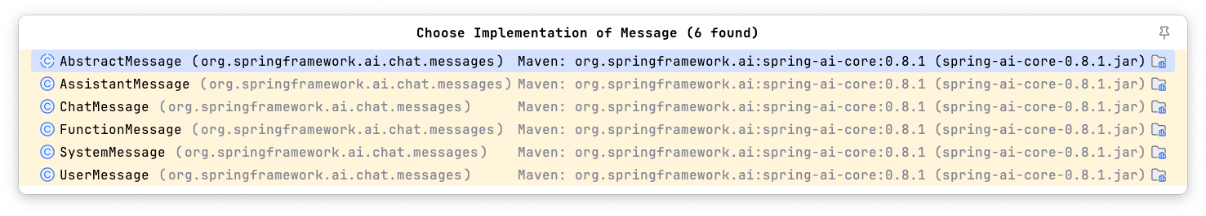
public class Prompt implements ModelRequest<List<Message >> { private final List<Message> messages;
private ChatOptions modelOptions;
public Prompt(String contents) { this((Message)(new UserMessage(contents)));
}
public Prompt(Message message) { this(Collections.singletonList(message));
}
public Prompt(List<Message> messages) { this.messages = messages;
}
public Prompt(String contents, ChatOptions modelOptions) { this((Message)(new UserMessage(contents)), modelOptions);
}
public Prompt(Message message, ChatOptions modelOptions) { this(Collections.singletonList(message), modelOptions);
}
public Prompt(List<Message> messages, ChatOptions modelOptions) { this.messages = messages;
this.modelOptions = modelOptions;
}

Slide 38
Roles
System Role: Guides the AI’s behavior and response style, setting parameters or rules for how the AI interprets and replies to the input. It’s akin to providing instructions to the AI before initiating a conversation.
User Role: Represents the user’s input – their questions, commands, or statements to the AI. This role is fundamental as it forms the basis of the AI’s response.
Assistant Role: The AI’s response to the user’s input. More than just an answer or reaction, it’s crucial for maintaining the flow of the conversation. By tracking the AI’s previous responses (its 'Assistant Role' messages), the system ensures coherent and contextually relevant interactions.
Function Role: This role deals with specific tasks or operations during the conversation. While the System Role sets the AI’s overall behavior, the Function Role focuses on carrying out certain actions or commands the user asks for. It’s like a special feature in the AI, used when needed to perform specific functions such as calculations, fetching data, or other tasks beyond just talking. This role allows the AI to offer practical help in addition to conversational responses.

Slide 39
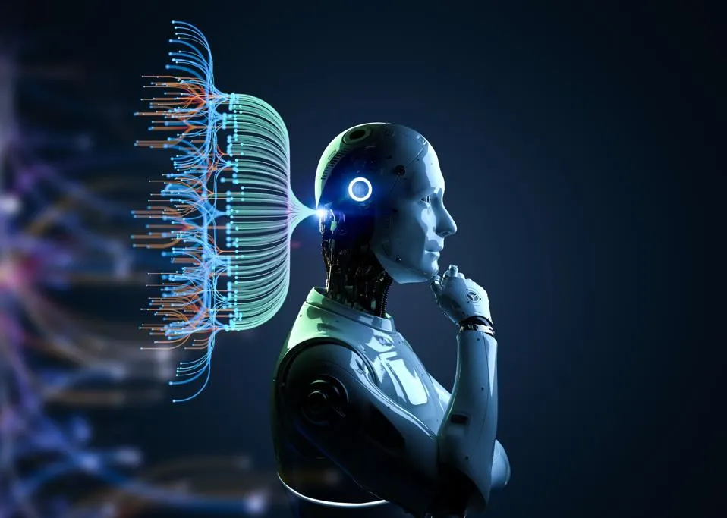
STRUCTURED OUTPUT

Slide 40

Output Parsing
Challenges with handling the response
The Challenge
Output of Generative LLM is a java.util.String
Even if you ask for JSON, you get a JSON String
ChatGPT wants to chat, not reply in JSON
OpenAI has introduced a new feature to help with this
Spring AI’s OutputParser uses refined prompts to desired results

Slide 41
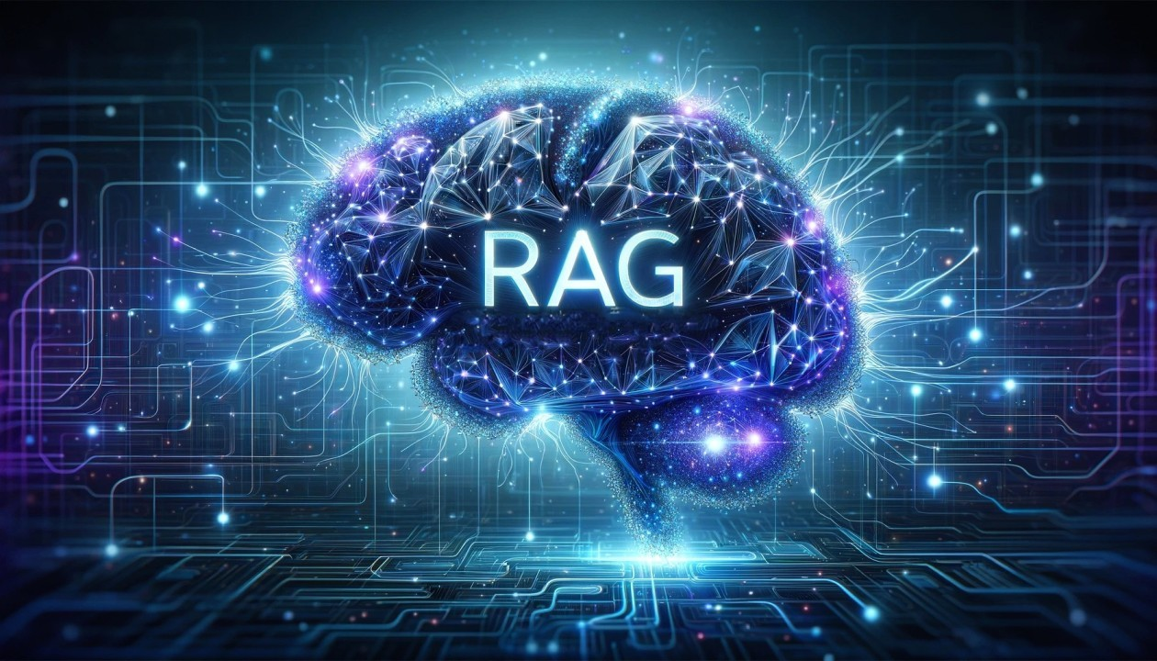
RETRIEVAL AUGMENTED
GENERATION

Slide 42
AI Application Architecture - RAG
?
Application
Argument
Prompt
LLM
Vector Store

Slide 43




Conceptual Flow of using RAG with LLMs
Search Relevant
Information
Knowledge
Sources
2
Query
Prompt
+
Query
Relevant
Information
Enhanced
context
1
3
Generate Text
Response
5
Prompt
+
Query
+
Enhanced
Context
4
Large Language Model EndPoint
https://aws.amazon.com/pt/what-is/retrieval-augmented-generation/

Slide 44
Vector Stores
Not just for text search
Azure Vector Search
ChromaVectorStore
MilvusVectorStore
Neo4JVectorStore
PgVectorStore
QdrantVectorStore
RedisVectorStore
WeaviateVecvtorStore
SimpleVectorStore

Slide 45
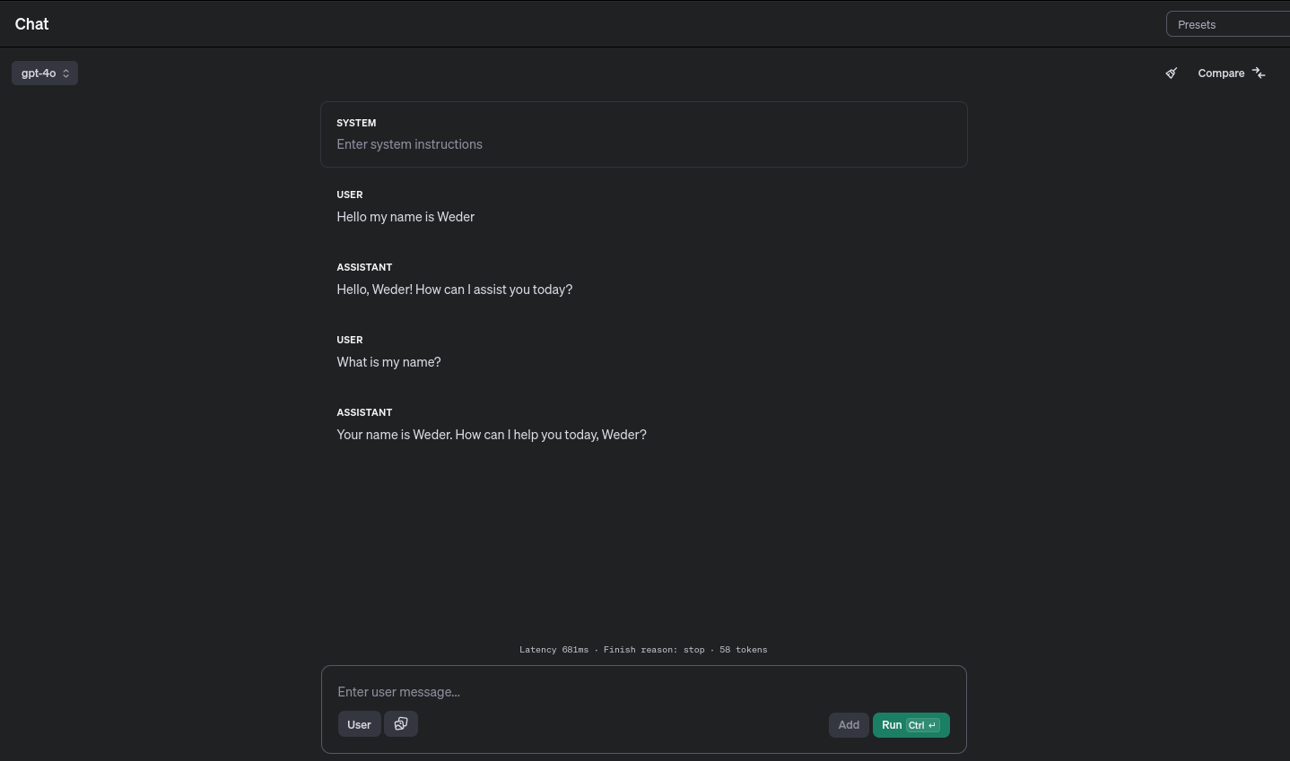

Slide 46
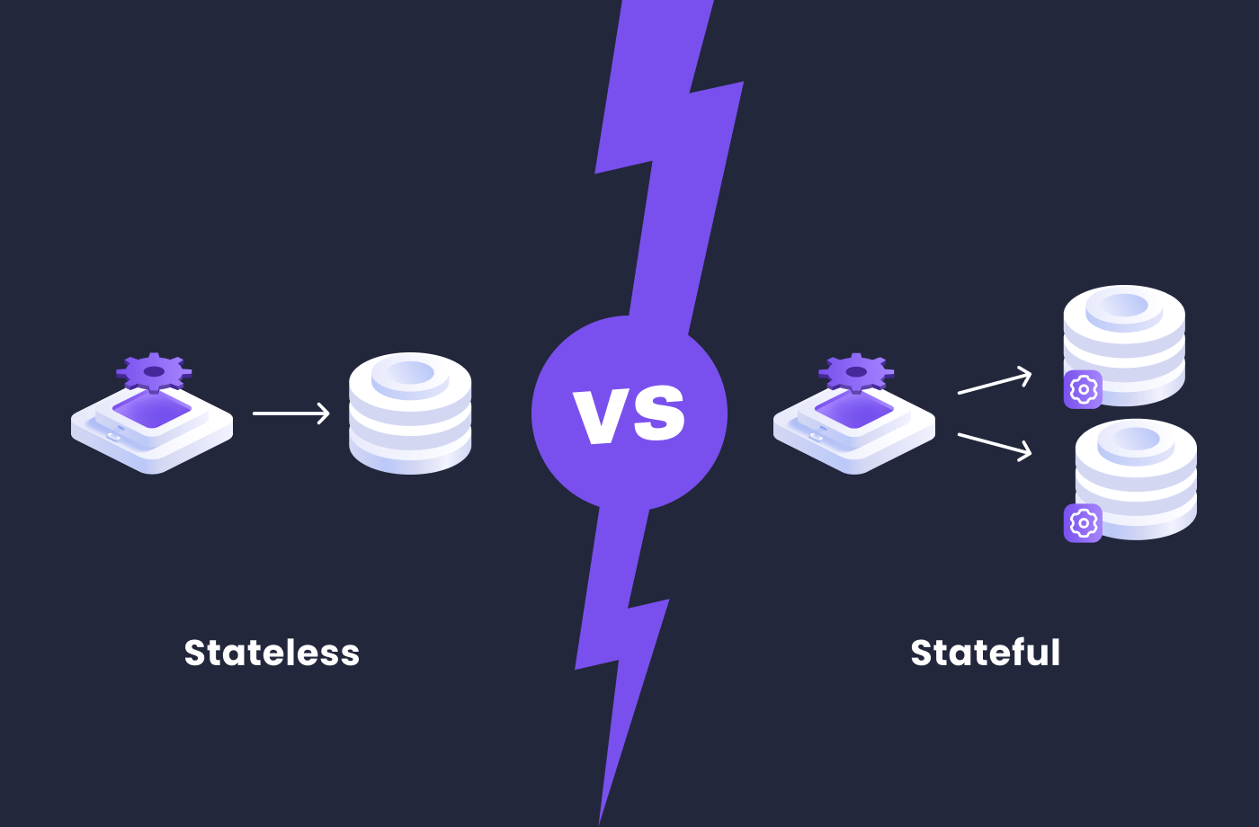
The web is stateless

Slide 47
Topic 2: Getting to Know OpenAI and AWS Bedrock

Slide 48
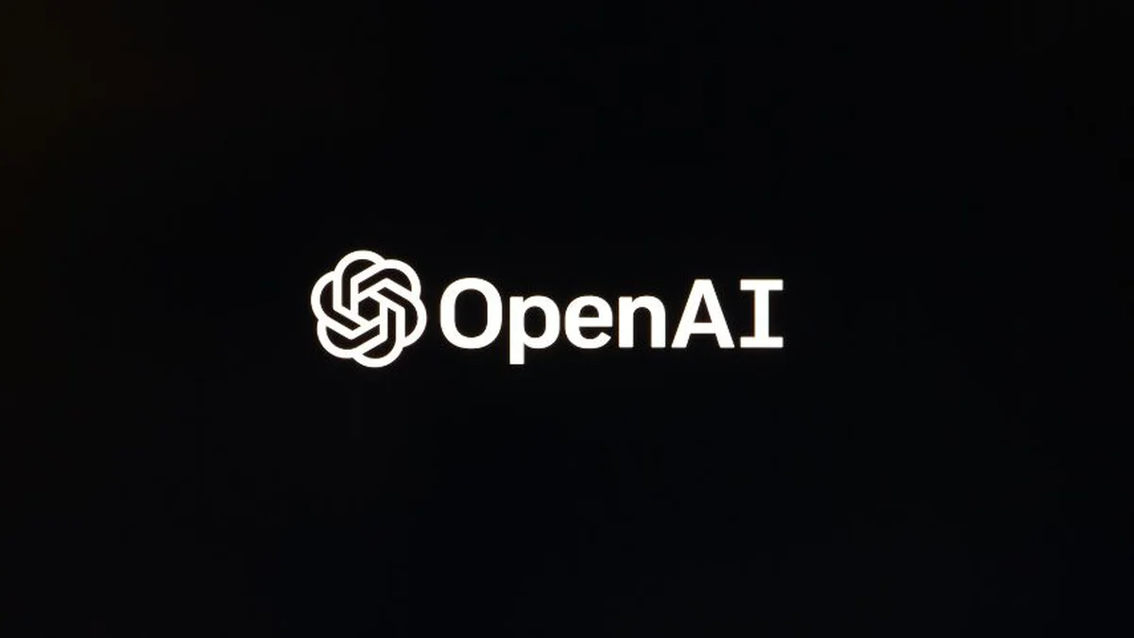

Slide 49
#! /bin/bash
echo "Calling Open AI"
MY_OPENAI_KEY="YOUR_API_KEY_HERE"
PROMPT="When was the first version of Java released?"
curl https://api.openai.com/v1/chat/completions \
-H "Content-Type: application/json" \
-H "Authorization: Bearer $MY_OPENAI_KEY" \
-d '{"model": "gpt-3.5-turbo-0125", "messages": [{"role":"user", "content": "'"${PROMPT}"'"}] }'

Slide 50
Response
Calling Open AI
{
"id": "chatcmpl-A5e48Ns4Tu9NscMH8oAIdClNF8dH6",
"object": "chat.completion",
"created": 1725909016,
"model": "gpt-3.5-turbo-0125",
"choices": [
{
"index": 0,
"message": {
"role": "assistant",
"content": "The first version of Java, known as Java 1.0, was released by Sun Microsystems on January 23, 1996.",
"refusal": null
},
"logprobs": null,
"finish_reason": "stop"
}
],
"usage": {
"prompt_tokens": 16,
"completion_tokens": 28,
"total_tokens": 44
},
"system_fingerprint": null
}

Slide 51
public static void main(String[] args) throws IOException, InterruptedException {
var apiKey = "YOUR_API_KEY_HERE";
var body = """
{
"model": "gpt-4",
"messages": [
{
"role": "assistant",
"content": "What is Spring Boot?"
}
]
}""";
HttpRequest request = HttpRequest.newBuilder()
.uri(URI.create("https://api.openai.com/v1/chat/completions"))
.header("Content-Type", "application/json")
.header("Authorization", "Bearer " + apiKey)
.POST(HttpRequest.BodyPublishers.ofString(body))
.build();
var client = HttpClient.newHttpClient();
var response = client.send(request, HttpResponse.BodyHandlers.ofString());
System.out.println(response.body());
}

Slide 52
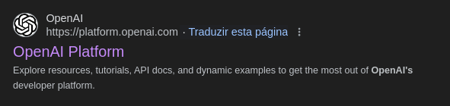
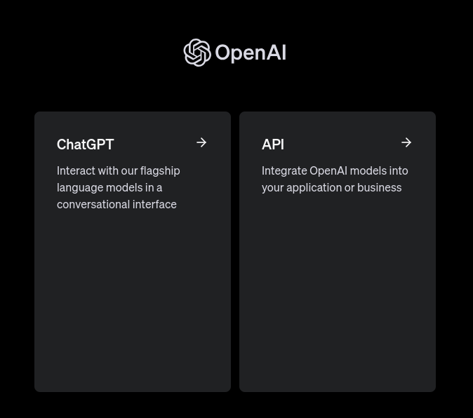

Slide 53
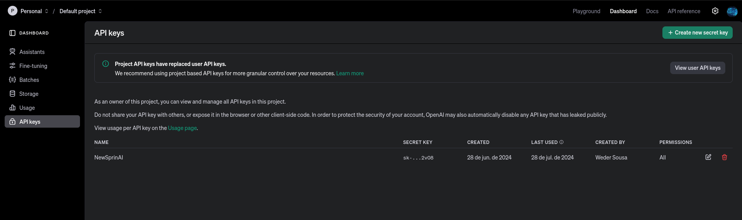

Slide 54
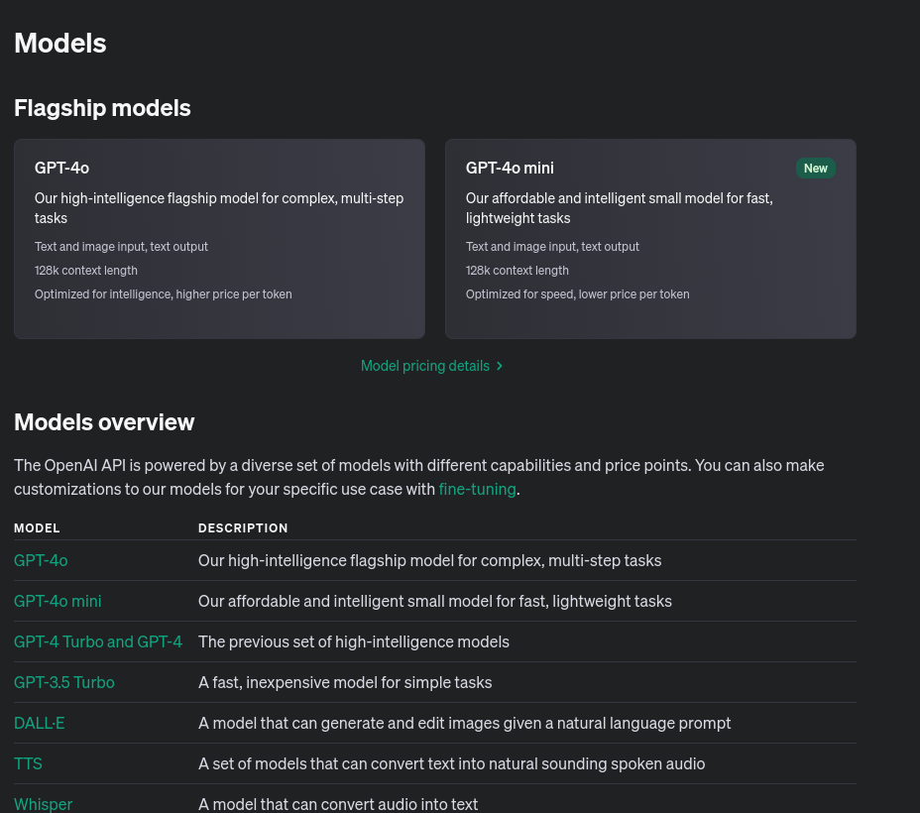
Models

Slide 55
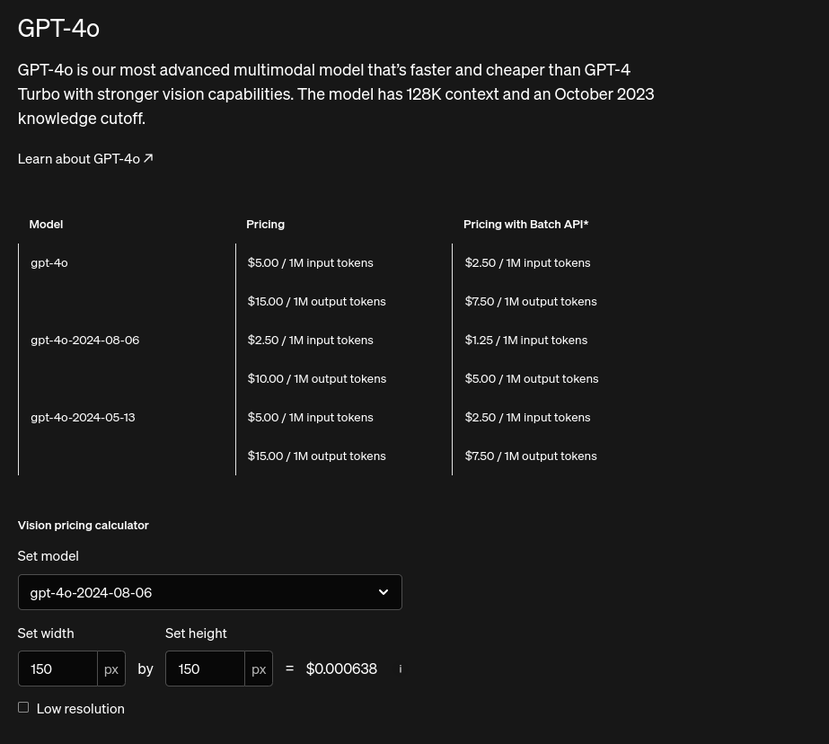
Tokens

Slide 56
WHAT ARE AI TOKENS?
AI
AI
AI
AI
AI

Slide 57
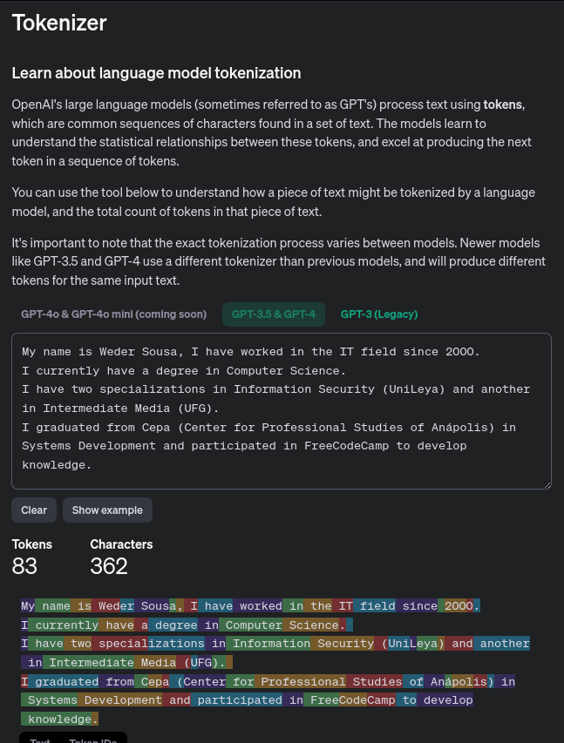
https://platform.openai.com/tokenizer

Slide 58


Slide 59


https://aws.amazon.com/pt/bedrock/?did=ap_card&trk=ap_card
Notes:
Amazon Bedrock is a managed platform that enables developers to build generative AI applications with security, privacy, and responsibility. It provides access to high-performance baseline models from leading AI companies such as Anthropic, Cohere, Meta, Stability AI, and Amazon through a single API. Here are some examples of serverless LLM applications that can be built using Amazon Bedrock:
Chatbots
Amazon Bedrock can be used to build chatbots for customer support, virtual assistants, and conversational applications. These chatbots can be integrated with enterprise systems to provide personalized responses and perform complex tasks.
Content Creation
Developers can use Amazon Bedrock to generate content for blogs, articles, and other written materials, as well as create synthetic data for training purposes.
Reflective Dialogue
Models such as Claude FM, available on Amazon Bedrock, are suitable for detailed and reflective conversations, ranging from content creation to complex reasoning and creative writing.
Image Generation
Amazon Bedrock supports the generation of unique, realistic, high-quality images, including artwork, logos, and designs, using models such as Stable Diffusion.
Serverless Document Chat
A specific example is a solution that allows you to ask natural language questions to any uploaded PDF document. It uses serverless services such as AWS Lambda to run LangChain and Amazon DynamoDB for conversational memory. Amazon Bedrock is used to provide serverless access to foundational models such as Amazon Titan and models developed by companies such as AI21 Labs, Anthropic, and Cohere.
Managed Agents
With Amazon Bedrock, you can create managed agents that perform complex tasks using enterprise systems and data sources. These agents can be created in just a few clicks by selecting a base model and providing access to enterprise systems, knowledge bases, and AWS Lambda functions to securely execute APIs.
These are just a few examples of how Amazon Bedrock can be used to build serverless LLM applications. The platform offers a wide range of use cases and tools that allow developers to experiment and evaluate the best base models for their specific needs, customize them with their data, and securely integrate them into their applications.

Slide 60
SIMPLE
SIMPLE
MACHINE LEARNING
INPUTS
OUTPUTS
DEEP LEARNING
COMPLEX
SIMPLE
INPUTS
OUTPUTS
FOUNDATION
MODELS
COMPLEX
COMPLEX
INPUTS
OUTPUTS

Slide 61







Foundation Models
+
+

Slide 62





Amazon Bedrock
The easiest way to build and scale generative AI applications with foundation models
Contextual answers, summarization, paraphrasing
Text summarization, generation, Q&A, search, image generation
Summarization, complex reasoning, writing, coding
Text generation, search, classification
Q&A and reading comprehension
Text summarization, Q&A, text classification, text completion, code generation
High-quality images and art
Jurassic-2 Ultra
Jurassic-2 Mid
Amazon Titan Text Premier
Amazon Titan Text Lite
Amazon Titan Text Express
Amazon Titan Text Embeddings
Amazon Titan Text Embeddings V2
Amazon Titan Multimodal Embeddings
Amazon Titan Image Generator
Claude 3 Opus
Claude 3 Sonnet
Claude 3 Haiku
Claude 2.1
Claude 2
Claude Instant
Command
Command Light
Embed English
Embed Multilingual
Command R+
Command R
Llama 3 8B
Llama 3 70B
Llama 2 13B
Llama 2 70B
Mistral Large
Mistral 7B
Mixtral 8x7B
Stable Diffusion XL1.0
Stable Diffusion XL 0.8
Notes:
With generative AI, every possible workload has a chance to be re invented. We are staring with chatbots and assistants, but as we build new use cases and workflows arise that can be enhanced with generative AI. This is the time to explore what is possible, and push the limits of what we can do. Now is the time to build!!!!

Slide 63
How does a foundation model work?
Data
Foundation model
Text
Images
Speech
Structured data
3D signals
Pre-train
*can take weeks or even months
Fine-tune for specific tasks and domains
*can take hours
Gather data at scale
Evaluate model

Slide 64
Architecture AWS Bedrock
Topic 6: Presentation of the integration architecture AWS Bedrock

Slide 65




Amazon Bedrock Serveless Basic Architecture
AWS Cloud
statics Pages
Amazon S3
Statics Pages
Users
Text Generation
Amazon API
Gateway
AWS Lambda
Amazon Bedrock

Slide 66






Advantages of the Serverless Approach
AWS Cloud
Dump vector index
Upload Document
Amazon S3
Statics Pages
Lambda function
Extract Document Metadata
Amazon SQS
Queue
Lambda function
Embed Documents
Get vector
Dump
Get LLM Response
AWS Amplify Hosting
React Application
Lambda function
Generate LLM
Response
Get Conversation
memory
Client
Amazon API
Gateway
Amazon Bedrock
Authenticate User
Lambda function
CRUD Operations
Amazon Cognito
Amazon DynamoDB
Conversation Memory

Slide 67












Advantages of the Serverless Approach
Amplify
Get Answer
Amazon API
Gateway
Lambda function
Amazon Bedrock
use
origins
Login
Users
Amazon CloudFront
Amazon S3
Amazon Cognito
React
Voice By
Microphone
text-to-speech
Amazon Polly

Slide 68

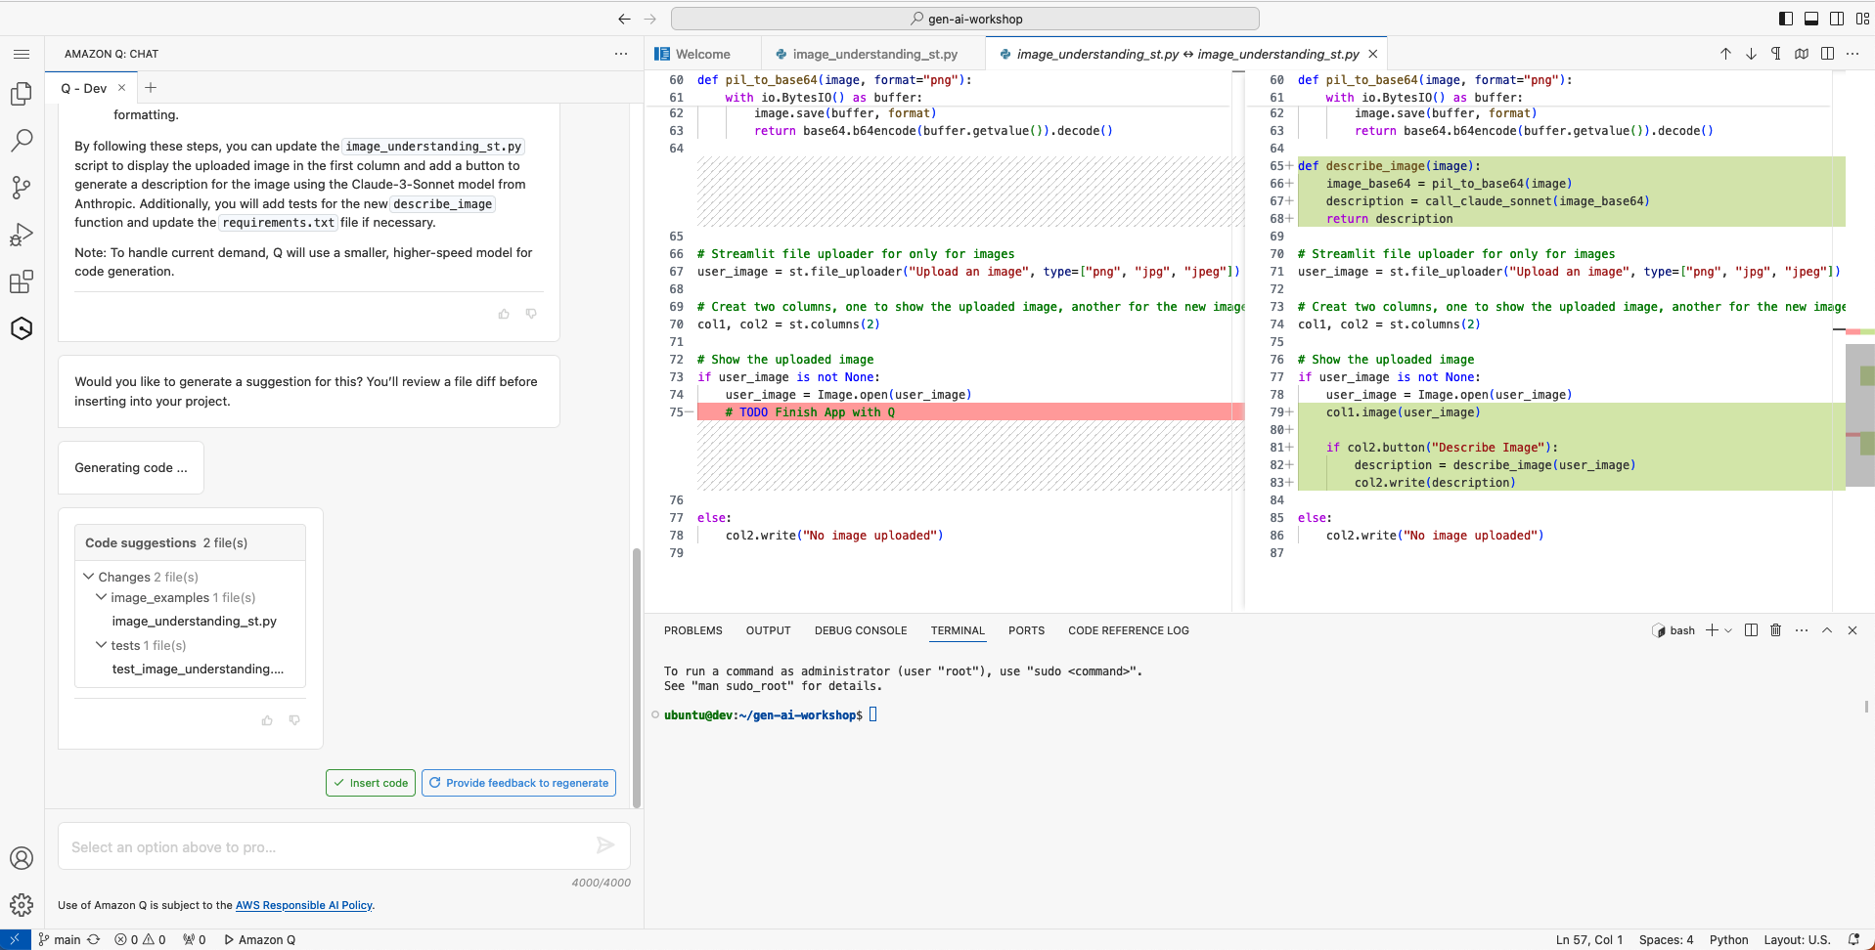
Amazon Q Developer
The most capable generative AI–powered assistant for software development

Slide 69


Slide 70
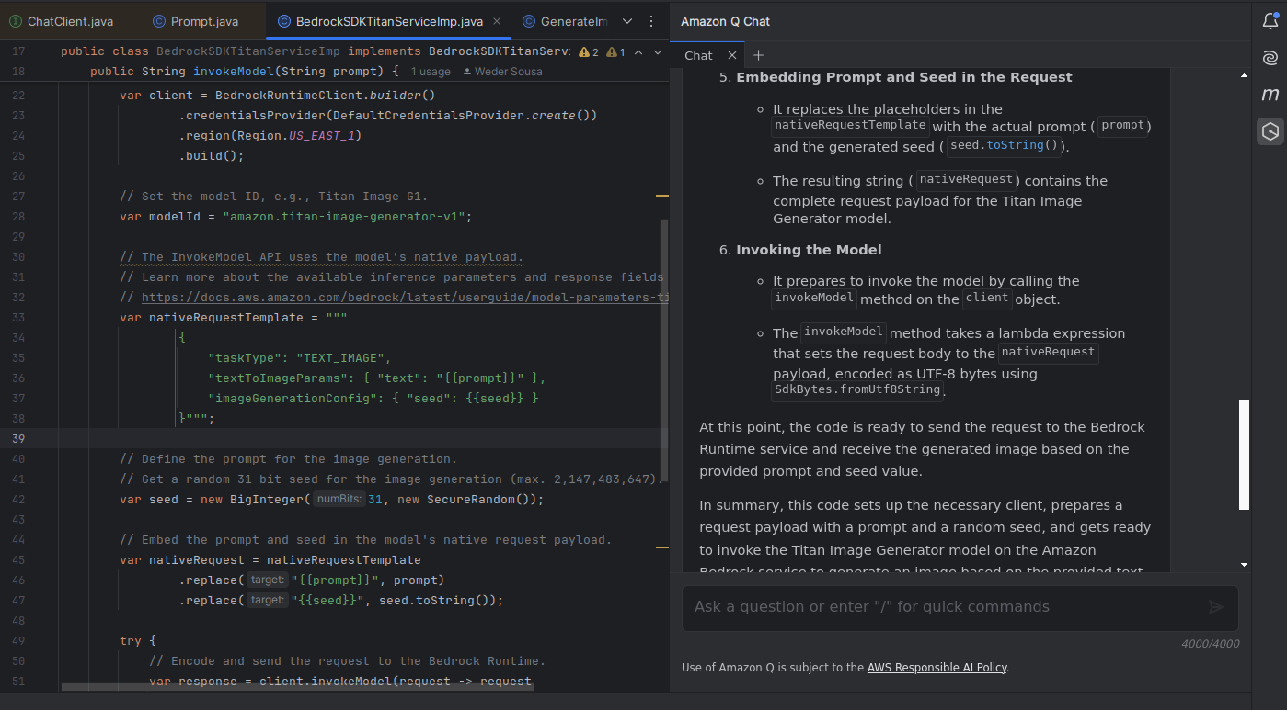

https://aws.amazon.com/pt/q/developer/?did=ap_card&trk=ap_card

Slide 71

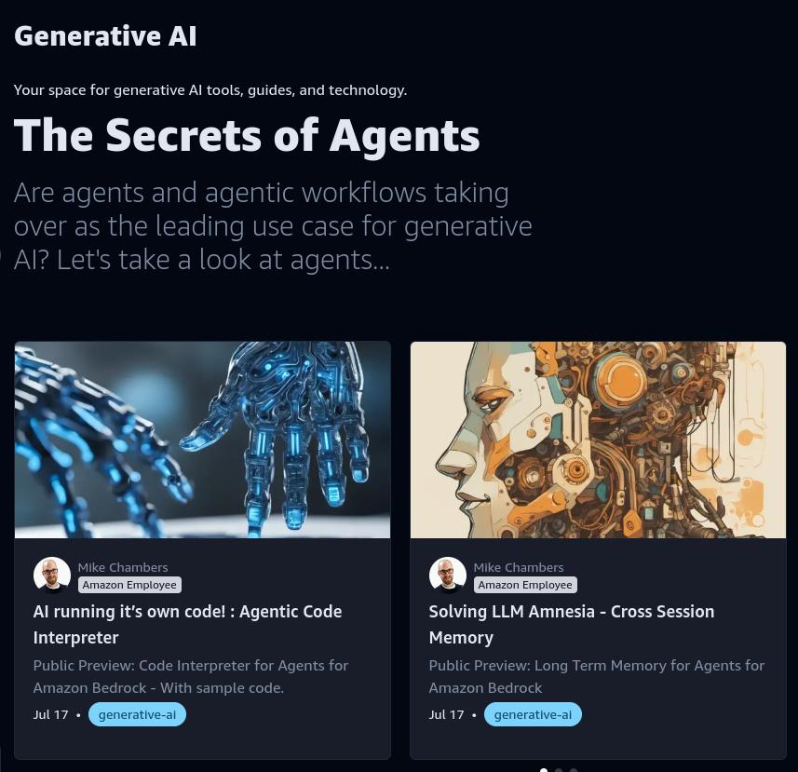

Generative AI
COMMUNITY

Slide 72
Topic 3: Integration: Spring AI with OpenAI (ChatGPT)

Slide 73
keep calm and
show me the code!

Slide 74
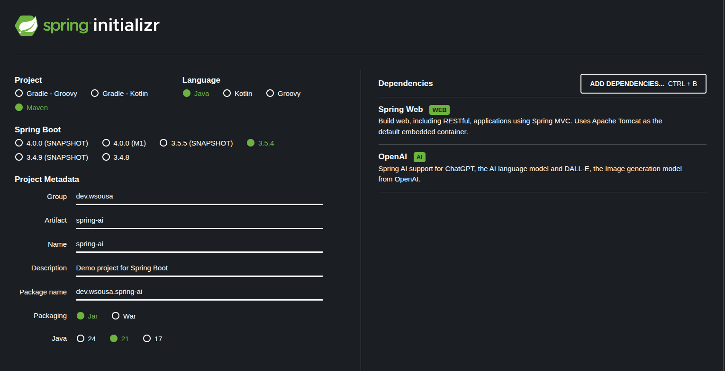

Slide 75

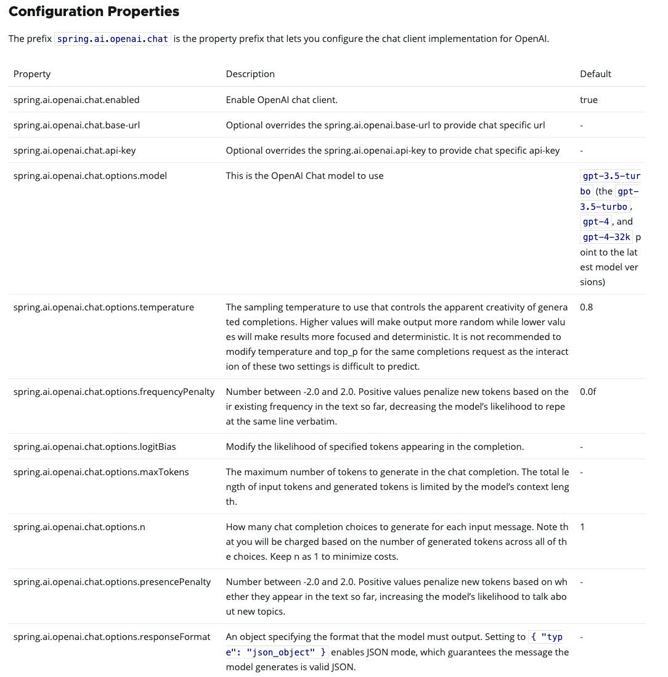
spring.application.name=hello-spring-ai spring.ai.openai.api-key=YOUR_KEY_HERE spring.ai.openai.chat.options.model=gpt-4

Slide 76
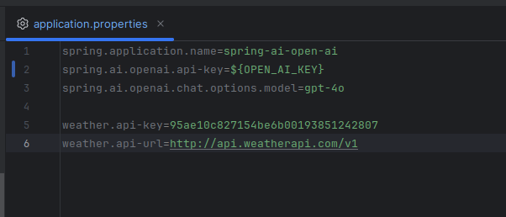

Slide 77
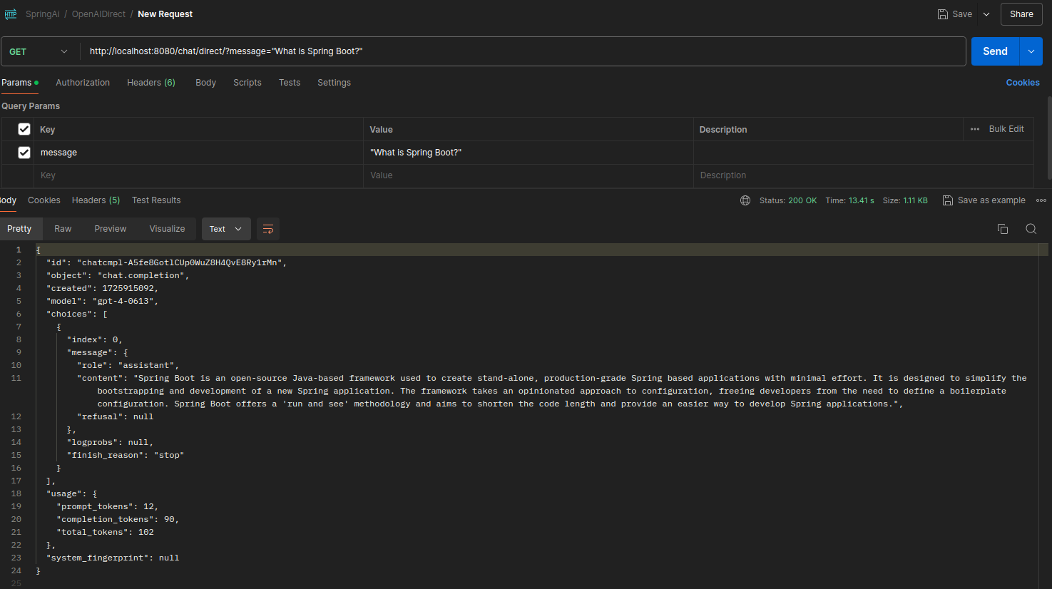

Slide 78
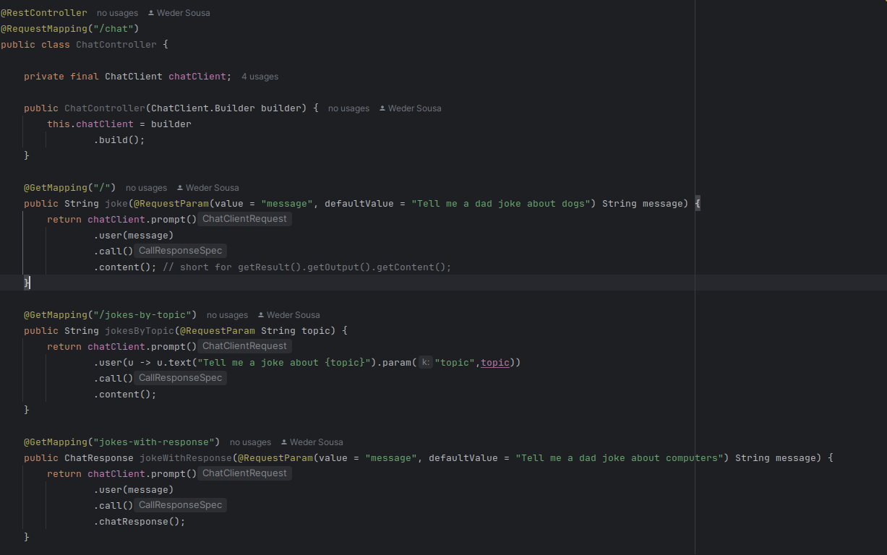
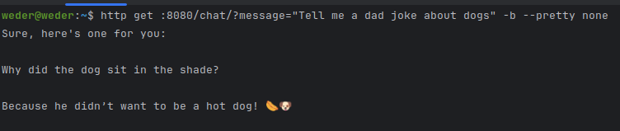
1
2

Slide 79
1

Slide 80
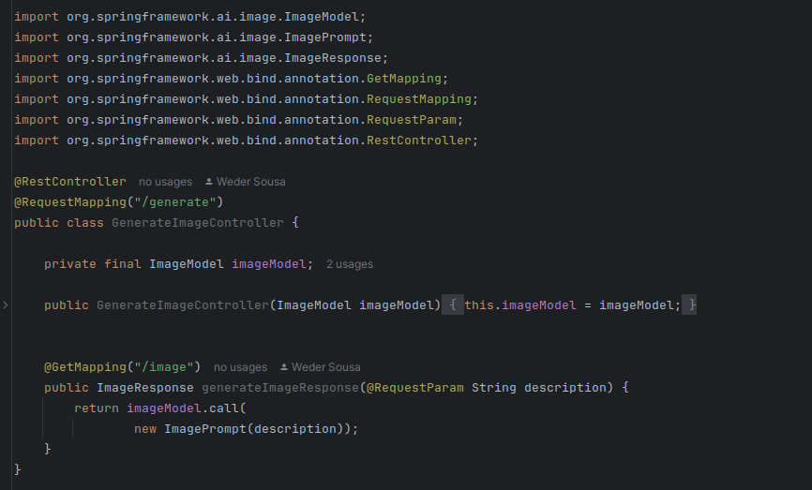


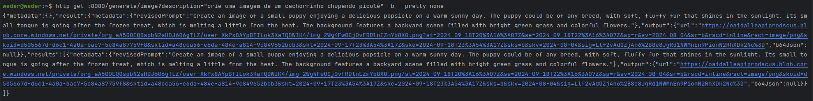
2
3
1

Slide 81

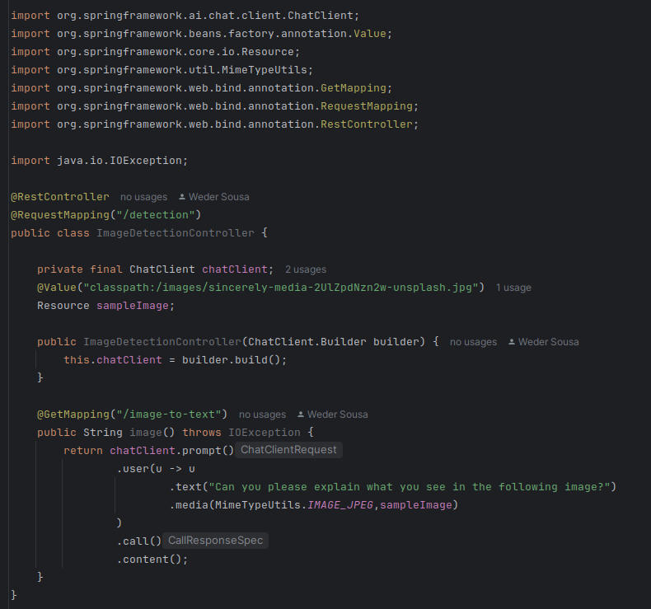
2
4
3
The image shows a workspace that includes a laptop
(an ASUS model), a smartphone, a pen, a notebook or
planner, and a coffee mug filled with coffee. Additionally,
there are several baby toys and accessories scattered around,
including a pacifier, a plush toy, colorful rings, and a small
wooden toy with wheels.
The setting suggests a combination of work and
childcare activities in the same space.
1
A imagem mostra um espaço de trabalho que inclui um laptop
(um modelo ASUS), um smartphone, uma caneta, um caderno
ou agenda e uma caneca de café cheia de café.
Além disso, há vários brinquedos e acessórios de bebê
espalhados, incluindo uma chupeta, um brinquedo de pelúcia,
anéis coloridos e um pequeno brinquedo de madeira com rodas.
O cenário sugere uma combinação de trabalho e atividades
de cuidados infantis no mesmo espaço.

Slide 82
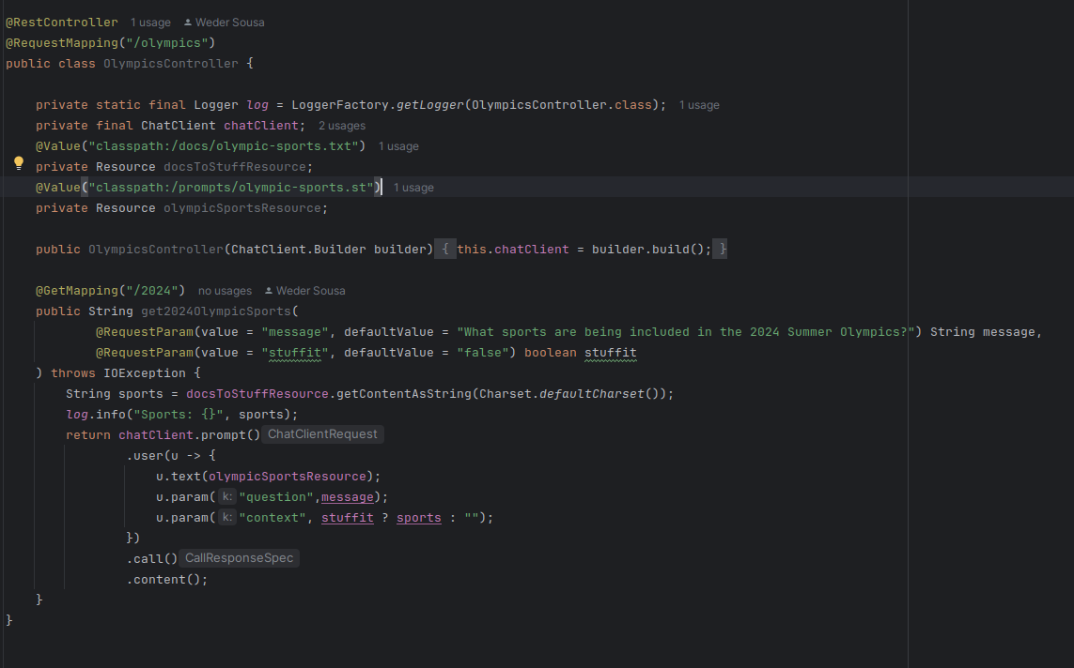
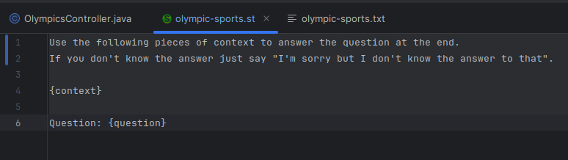
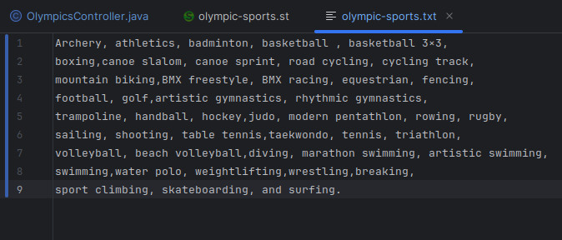
1
1
2
I'm sorry but I don't know the answer to that.
3

Slide 83
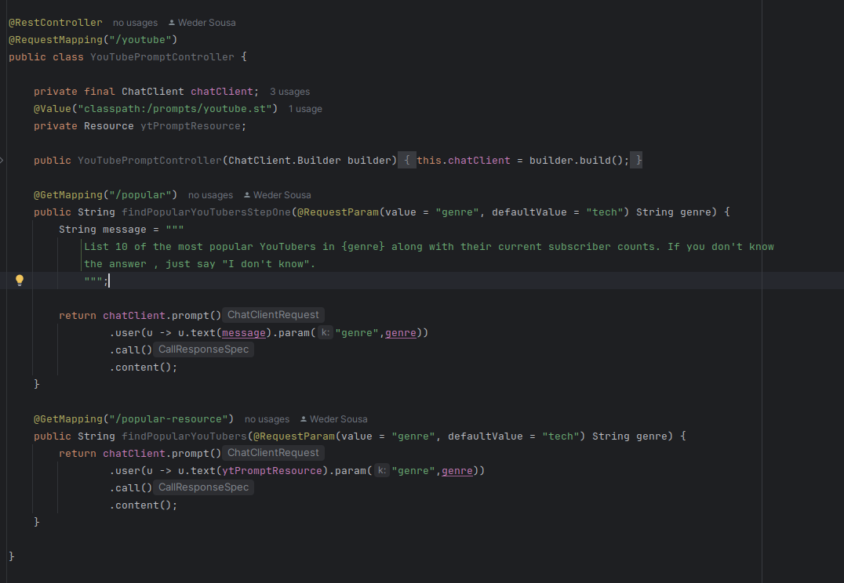
I don't have real-time access to current data, so I can't provide the exact
subscriber counts for YouTubers. However, I can certainly list some of the
most popular tech YouTubers as of my last update:
1. Marques Brownlee (MKBHD)
2. Linus Tech Tips
3. Unbox Therapy
4. Dave Lee (Dave2D)
5. Austin Evans
6. Jonathan Morrison (TLD)
7. iJustine
8. The Verge
9. Android Authority
10. Mrwhosetheboss
For the most up-to-date subscriber counts, I recommend visiting their YouTube
channels directly.
1
2

Slide 84
Topic 4: Integration: Spring AI with AWS (Bedrock)

Slide 85
Amazon Bedrock
keep calm and
show me the code!

Slide 86
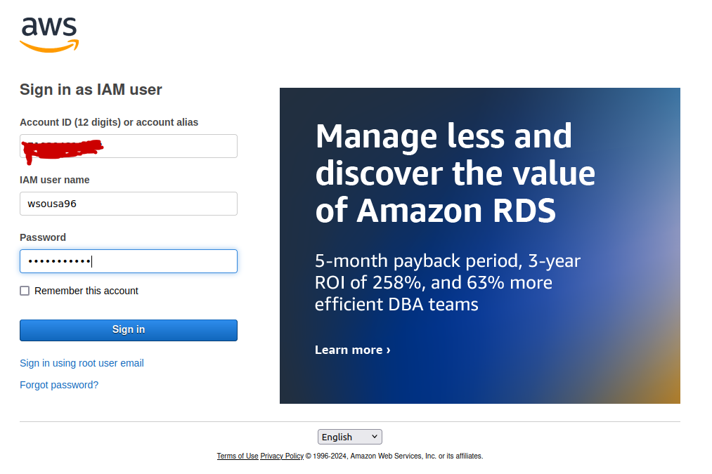

Slide 87
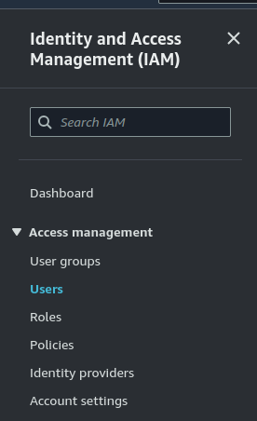
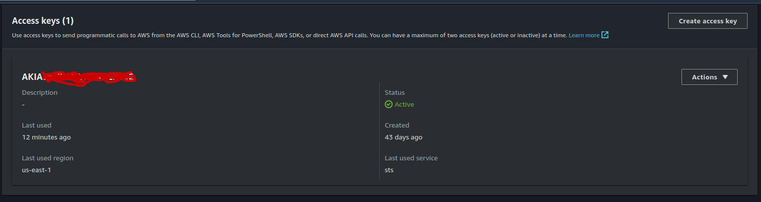
1
2
2
3

Slide 88
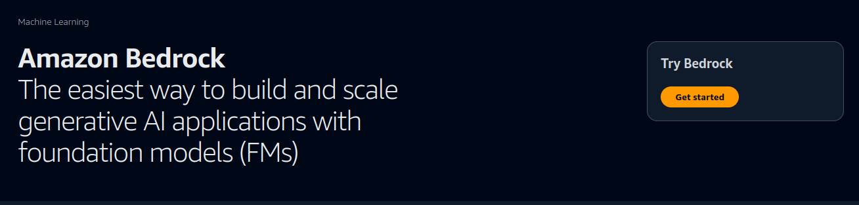
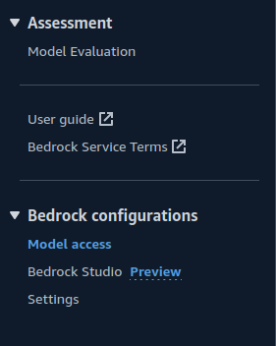
1
2

Slide 89
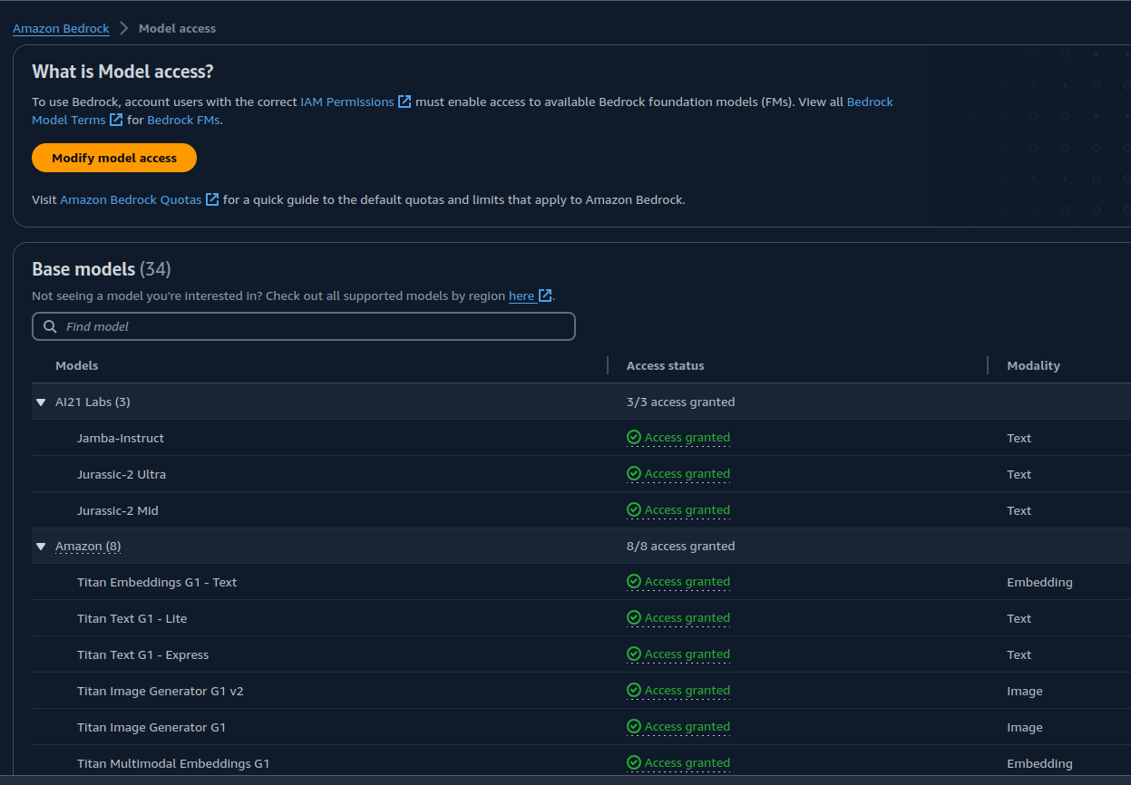
1
3
4
2

Slide 90


1
2

Slide 91

1

Slide 92

1
2

Slide 93

1

Slide 94

1

Slide 95

Next Steps

Slide 96



Getting started
Get started with Amazon Bedrock
Discover features with a step-by-step tutorial
Dive deep with a
hands-on workshop

Slide 97


GenAI Roadshow - Virtual

Slide 98


Amazon Web Services Latin America

Slide 99
Resources
#Links (Bedrock)
https://www.ranthebuilder.cloud/post/automating-api-calls-with-agents-for-amazon-bedrock-with-powertools
https://www.slightinsight.com/tech/developing-a-spring-boot-application-with-amazon-bedrock-api/
https://community.aws/content/2dhKdwyY1kzhFTg9CTLbaJ9MmTN/build-generative-ai-applications-with-amazon-bedrock
https://www.eficode.com/blog/building-ai-on-aws-bedrock-brings-brilliant-building-blocks?utm_campaign=AWS&utm_content=189323971&utm_medium=social&utm_source=twitter&hss_channel=tw-142208607
https://cloudacademy.com/learning-paths/integrating-aws-services-with-llms-and-other-fms-14068/
https://www.youtube.com/watch?v=CE_-zrMvcuk&list=PLhr1KZpdzukfmv7jxvB0rL8SWoycA9TIM&index=5
https://programadriano.medium.com/conhecendo-o-amazon-bedrock-c687c7e9777f
https://github.com/AWS-Cloud-Drops-Builders-Edition/show?tab=readme-ov-file
https://levelup.gitconnected.com/ai-powered-video-summarizer-with-amazon-bedrock-and-anthropics-claude-9f1832f397dc
https://catalog.workshops.aws/persona-based-access-genai-application/en-US/04-testing-application/01-updating-code
https://dev.to/aws-builders/have-fun-with-aws-partyrock-3755
https://dev.to/aws-builders/build-serverless-generative-ai-api-service-with-aws-lambda-and-amazon-bedrock-3abc
https://norahsakal.medium.com/how-to-use-aws-titans-ai-multimodal-embeddings-for-better-e-commerce-recommendations-b9f4adb60c02
https://www.linkedin.com/pulse/aplica%C3%A7%C3%B5es-serverless-llm-com-amazon-bedrock-diogo-santos-yjo3f/
https://aws.amazon.com/pt/blogs/aws-brasil/crie-aplicativos-de-ia-generativa-usando-o-aws-step-functions-e-o-amazon-bedrock/
https://community.aws/generative-ai
https://aws.amazon.com/pt/what-is/retrieval-augmented-generation/
#Important

Slide 100
Resources
#Links Spring AI OpenAI
https://github.com/danvega/hello-gpt/blob/main/src/main/java/dev/danvega/Application.java
https://www.youtube.com/watch?v=yyvjT0v3lpY&list=PLZV0a2jwt22uoDm3LNDFvN6i2cAVU_HTH
https://tecnoblog.net/guias/4-sites-gratis-para-transcrever-video-do-youtube/
https://www.youtube.com/watch?v=azKntWC6d3w
https://github.com/kousen/openaidemo
https://www.youtube.com/watch?v=ZeH3bBKdqRU
#Spring AI Vector
#Top

Slide 101
About Me
Q & A
Weder Mariano de Sousa
Specialist Senior Java - GFT
Technician System Development
Graduated Computer Science
Serverless
Post Graduate in Midias UFG
https://www.linkedin.com/in/wedermarianodesousa/
Post Graduate in Information Security
https://github.com/weder96
https://twitter.com/weder96
https://dev.to/weder96
GOJava
AWS User
Group Goiânia
AWS User
Group Anápolis

Slide 102
THANK YOU

